Slide 1

Welcome to SQL Saturday Denmark

Slide 2
Do You Trust Me?
Even just a little bit.

Slide 3
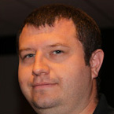
About Me
My name is John and I work for SQL Sentry :-)
Twitter : @SQLDiplomat
Email : jmartin@sqlsentry.com
Blog : http://blogs.sqlsentry.com/author/JohnMartin
3 |

Slide 4
Talking About?
The risk of trusting a database.

Slide 5
Demo
Why So Serious?

Slide 6
Summary
Database Owner is Sysadmin
Members of db_owner OR users can impersonate db_owner
Database has TRUSTWORTHY on.
Risk of Privilege Escalation

Slide 7

Questions

Slide 8
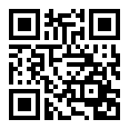
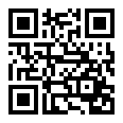
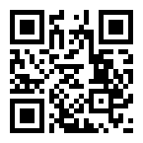
Thank You !
Please review the event and sessions
EVENT
SESSION
INSERT QR CODE FROM WORD DOCUMENT and CHANGE THE URL AS WELL
http://speakerscore.com/ZGVX
http://speakerscore.com/W7WJ

